Slide 1


General Chemistry
Al-Karkh University for Science
Collage of Science
Lectures
Dr. Mohammed A. B. Abdul Jabar
Ph.D chemistry (Inorganic Chemistry)

Slide 2
Syllabus Content
Subject | Lec. No.
An introduction to chemistry | 1, 2
Drawing Lewis Structures | 3
Preparation of standard solution | 4
Statistical treatment of analytical data | 5
Chemical Reactions | 6
Acids and Bases | 7
Buffer solutions | 8, 9
Titrimetric Methods | 10
Examples of Titration Curves | 11
Complexometric titrations | 12
Precipitation methods (Gravimetry) | 13
Spectroscopy | 14
Final Exam | 15

Slide 3
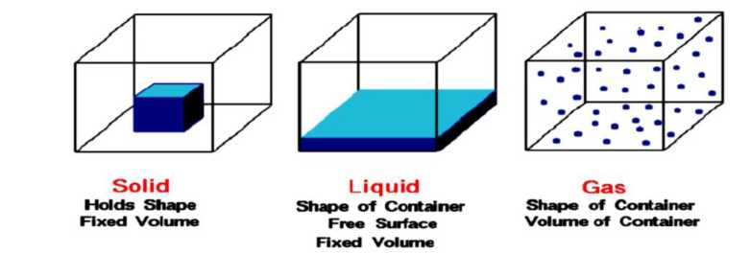
General Chemistry
References:
1- General chemistry by Darrell D. Ebbing, 2007.
2- fundamentals-of-chemistry by Romain Elsair, 2012.
3- Fundamentals of Analytical Chemistry by Stook and West 2012.
4- Basic concepts in biochemistry by Hiram F. Gilbert, 2000.
5- Organic chemistry by Morrison and Boyd 7th, 2010.
6- Instant Notes in General Chemistry by Mohammed Abdul Baset, Printed by Dar Alayam, Amman-Jordan, 2014, 299 p.
Lectures 1, 2
Dr. Mohammed Abdul Baset
An introduction to chemistry
Matter
• Matter is anything which has mass and takes up space (volume)
• Examples of matter: Sand (a solid), Water (a liquid), Air (a mixture of gases)
Solids have shape and volume. Liquids have volume but adopt the shape of their container. Gases occupy the shape and volume of their container.
Substances
A substance is a form of matter that has constant chemical composition and characteristic properties. There are two kinds of substances—elements and compounds. Element is a pure chemical substance consisting of one type of atom. Compound is a pure chemical substance consisting of two or more different chemical elements.
Physical Properties
The properties related to the state (gas, liquid, or solid) or appearance of a sample are called physical properties. Some commonly known physical properties are density, state at room temperature, color, hardness, melting point, and boiling point.
Chemical Properties
A chemical properties is a change in which at least one substance changes its composition and its set of properties. Examples: flammability, rust resistance, reactivity.
1

Slide 4
Classification of matter (substance)
Therefore, matter is classified according to several different schemes. Matter may be classified as organic or inorganic. Other schemes are based on chemical properties of the various classes. For example, substances may be classified as acids, bases, or salts. In the method of classification of matter based on composition, a given specimen of material is regarded as either
a pure substance or a mixture.
Pure substance
Matter that has a constant composition and fixed properties.
Mixture
A physical blend of matter that can theoretically be physically separated into two or more components.
Homogeneous matter
Matter that has the same properties throughout the sample.
Solutions
Homogeneous mixtures of two or more pure substances.
Heterogeneous matter
Matter with properties that are not the same throughout the sample.
Molecule
A molecule is comprised of two or more chemically bonded atoms. The atoms may be of the same type of element, or they may be different.
> Molecular formulas refer to the actual number of the different atoms which comprise a single molecule of a compound.
> Empirical formulas refer to the smallest whole number ratios of atoms in a particular compound.
Compound | Molecular Formula | Empirical Formula
Water | H2O | H2O
Hydrogen Peroxide | H2O2 | HO
Ethylene | C2H4 | CH2
Ethane | C2H6 | CH3
Ion
An ion is a particle (an atom or group of atoms) carrying positive or negative charge. Sometimes atoms gain or lose electrons. Positive Ion (cation) - Occurs when an atom loses an electron, it has more protons than electrons. Negative Ion (anion) - Occurs when an atom gains an electron, it will have more electrons than protons.
Atoms
Atoms are the basic unit of chemistry. They consist of 3 smaller things:
Protons - these are positively charged (+)
Electrons - these are negatively charged (-)
Neutrons - these have no charge
2

Slide 5
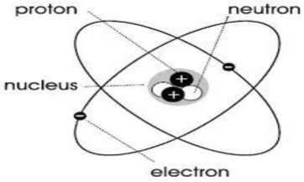

These 3 smaller particles are arranged in a particular way. In the center is the Nucleus where you find the positive Protons and neutral Neutrons. In orbit around the nucleus are the Electrons.
We use the following symbol to describe the atom:
Mass number = A
X= element symbol (see periodic table)
Atomic number = Z
Atomic number of an atom
A number equal to the number of protons in the nucleus of an atom. Symbolically it is represented by Z.
Z= Nuclear charge = number of protons
Mass number of an atom
A number equal to the sum of the number of protons and neutrons in the nucleus of an atom. Symbolically it is represented by A.
A= Mass Number = Number of protons + Number of neutrons
Periodic Table of the Elements
Periods and Groups
• The periodic table is a tabular arrangement of the chemical elements, organized on the basis of their atomic numbers, electron configurations (electron shell model), and recurring chemical properties.
• The first reasonably successful attempt was made by Dimitri Mendeleev in 1869. He had the idea of arranging elements in order of increasing atomic mass, and, most importantly, found that elements with similar chemical and physical properties occurred periodically. He placed these similar elements under each other in columns.
• In 1914, Henry Moseley determined that a better arrangement was in order of increasing atomic number, giving us the periodic table we have today.
• We can define the periodic table as an arrangement of elements in order of increasing atomic number placing those with similar chemical and physical properties in columns.
• The basic structure of the periodic table is its division into rows and columns, or periods and groups. A period consists of the elements in any one horizontal row of the periodic table. A group consists of the elements in any one column of the periodic table.
3

Slide 6
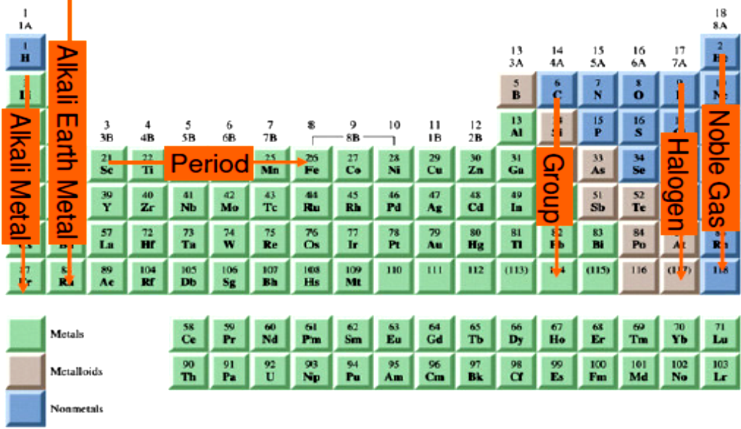
Non metal i
• The groups are usually numbered. The numbering frequently seen in North America labels the groups with Roman numerals and A’s and B’s. In Europe, a similar convention has been used, but some columns have the A’s and B’s interchanged.
• To eliminate this confusion, the International Union of Pure and Applied Chemistry (IUPAC) suggested a convention in which the columns are numbered 1 to 18. When we refer to an element by its periodic group, we will use the traditional North American convention. The A groups are called main-group (or representative) elements; the B groups are called transition elements. The two rows of elements at the bottom of the table are called inner transition elements (the first row is referred to as the lanthanides; the second row, as the actinides).
1. Metals
o solids at room temperature (except Hg)
o metallic luster o malleable and ductile
o good conductors of heat and electricity.
2. Non-metals
o gases or solids at room temperature (except Br₂)
o variety of color and appearance
o brittle solids
o insulators (poor conductors)
3. Metalloids (semimetal)
o intermediate in properties between metals and non-metals
o solids at room temperature
o many have more than one structure (one metallic, the other non-metallic)
o some are semi-conductors
4

Slide 7
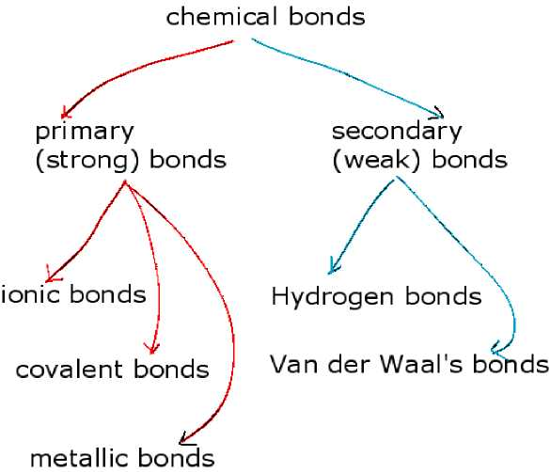
Main Group Elements (Vertical Groups)
Group 1(IA) - Alkali Metals
Group 2(IIA) - Alkaline Earth Metals
Group 13(IIIA) - Boron Family
Group 14(IVA) - Carbon Family
Group 15(VA) - Nitrogen Family
Group 16(VIA) - Oxygen Family (Chalcogens)
Group 17(VIIA) - Halogens
Group 18(VIIIA) - Noble Gases
Other Groups ( Vertical and Horizontal Groups)
Group 3-12(IB - 8B) - Transition Metals
Period 6 Group - Lanthanides (Rare Earth Elements)
Period 7 Group - Actinides
The Chemical Bond
A chemical bond is a strong force of attraction, which holds atoms together in molecules.
The Classification of Chemical Bonds
There are two major bond classifications, each with identifiable sub-groups:
Primary Bonds (Strong 100-1000 Kj/mol)
The three types of primary bonding reflect these ways in which atoms can group together by gaining or losing or sharing electrons, so they can get inert gas electron configurations.
1. Ionic Bonds
Atoms near the left or right sides of the periodic table can loose or gain 1 (or 2) electrons to form charged "ions". For example, a Sodium atom (row 3, column IA) can loose one electron to have 8 valence electrons and become a positively charged "cation". A Chlorine atom (row 3, column VIIA) can gain one electron to have 8 valence electrons and become a negatively charged "anion".
5

Slide 8
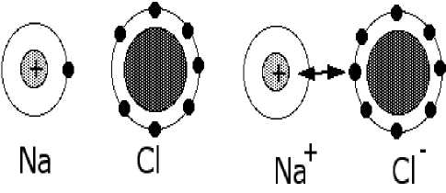
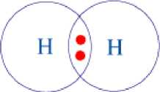
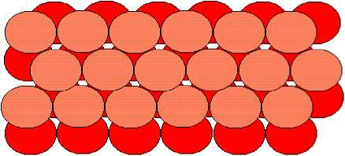
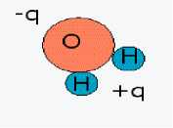
2. Covalent Bonds
In covalent bonding atoms share electrons.
Take for example the H₂ molecule. Since each hydrogen has only one electron, when two hydrogens get together they can share their electrons.
Pure hydrogen exists as H₂ molecules.
3. Metallic Bonds
The atoms are ionized, losing some electrons from the valence band. Those electrons from an electron sea, which binds the charged nuclei in place.
Metallic bonding occurs between the positive atom cores and the "nearly free" electrons.
In metallic bonding:
• there are no charge requirements,
• there are no directional requirements, and
• there are long range effects.
This means that in metallic bonding the atoms pack together as closely as possible.
Metallic solids occur when large numbers of atoms bond together in close-packed structures.
They can be modelled as ping-pong balls glued together as shown in the diagram.
Secondary Bonds (Weak <100 Kj/mol)
No electrons transferred or shared. Secondary or weak bonds are formed when there is effectively a partial and/or momentary charge.
1. Hydrogen bonding
Hydrogen bonding is the most common type of bonding between permanent dipoles. The situation that leads to Hydrogen bonding arises with a normal bond between a Hydrogen atom and a neighbor. Since any other atom will bind the electron from the Hydrogen atom more tightly, the electron will spend more time with the other atom. This creates a permanent dipole (a partially exposed proton) that can interact with other dipoles nearby.
The water molecule (H2O) is the classic situation, where the Oxygen molecule binds electrons from both Hydrogen atoms more tightly than Hydrogen can. Hydrogen bonding between water molecules makes ice less dense than water so, in winter, rivers freeze down from the top and not up from the bottom, enabling life to survive.
6

Slide 9
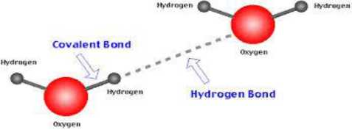
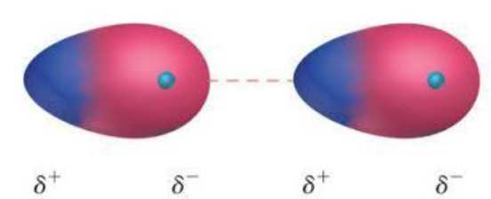
2. Van der Waals Bonds
The dipoles involved in Van der Waals bonding come from fluctuations in the symmetry of the electron distribution surrounding the nucleus of an atom. Momentary electric dipoles are set up and give rise to weak, very short-range, non-directional attractive forces between molecules or atoms. Example: Ni atom
7

